Slide 1

CIT-2180 Data and Database Management Chapter 6

Slide 2

Oracle 12C: SQL
Chapter 6
Additional Database Objects

Slide 3
Database Objects
An object is anything that has a name and defined structure
Includes:
Table – stores data
Sequence – generates sequential integers
Index – allows users to quickly locate specific records
Synonym – alias for other database objects
3

Slide 4
Sequences
Used for internal control purposes by providing sequential integers for auditing
Used to generate unique value for primary key column
Surrogate key = no correlation with actual row contents
4

Slide 5
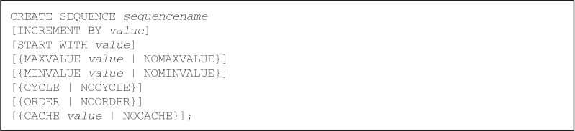
Creating a Sequence
Use the CREATE SEQUENCE command
Various intervals are allowed – Default: 1
Various starting numbers allowed – Default: 1

Slide 6
Creating a Sequence (continued)
Can specify MINVALUE for decreasing sequence and MAXVALUE for increasing sequence
Numbers can be reused if CYCLE is specified
6

Slide 7
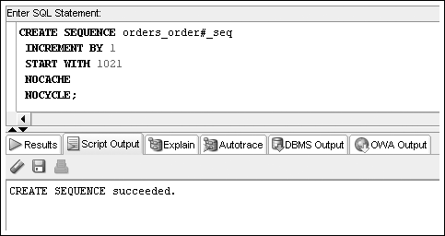
Creating a Sequence (continued)
7

Slide 8
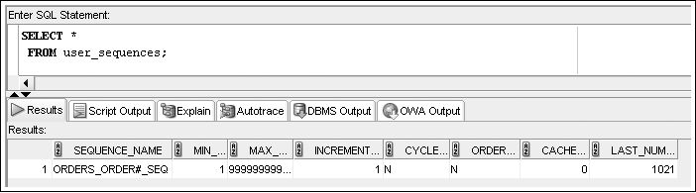
Creating a Sequence (continued)
To verify the settings for options of a sequence, query USER_SEQUENCES data dictionary view
Next Number to issue

Slide 9
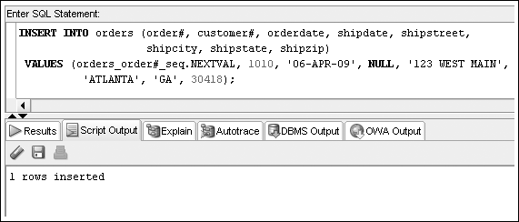
Using Sequence Values
sequencename.NEXTVAL generates next integer

Slide 10
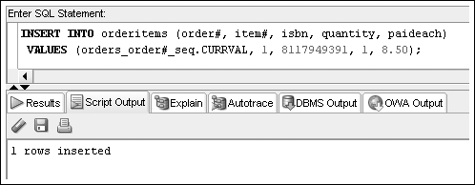
Using Sequence Values (continued)
sequencename.CURRVAL for current value

Slide 11
Altering Sequence Definitions
Use ALTER SEQUENCE command to change the settings for a sequence
START WITH value cannot be altered – drop the sequence and re-create it
Changes cannot make current integers invalid
11

Slide 12
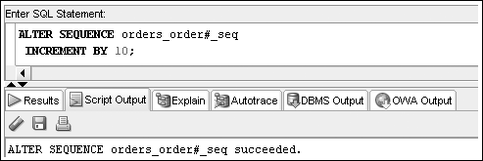
ALTER SEQUENCE Command Example
12

Slide 13
Removing a Sequence
Use the DROP SEQUENCE command to delete a sequence
Previous values generated are not affected by removing a sequence from a database

Slide 14
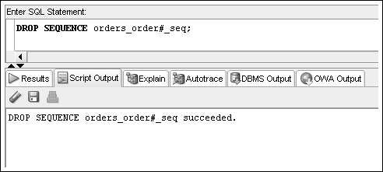
Removing a Sequence (continued)

Slide 15
Indexes
An index stores frequently referenced values and ROWIDs
Can be based on one column, multiple columns, functions, or expressions
15

Slide 16
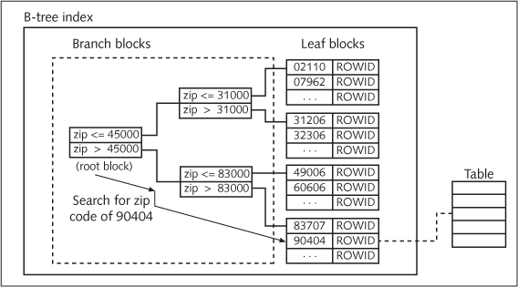
B-Tree Index
16

Slide 17
B-Tree Index (continued)
Implicitly create an index by PRIMARY KEY and UNIQUE constraints
Explicitly create an index by using the CREATE INDEX command
17

Slide 18
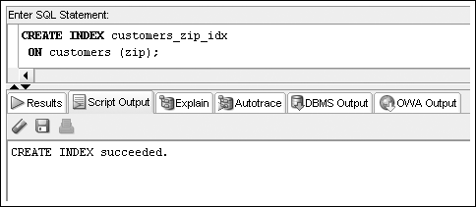
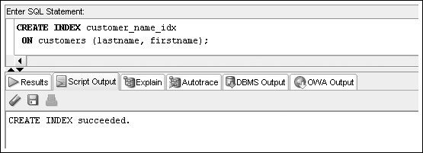
CREATE INDEX Command Examples
18

Slide 19
Verifying an Index
Use the USER_INDEXES data dictionary view to determine that the index exists
Use the USER_IND_COLUMNS data dictionary view to determine the column index information

Slide 20
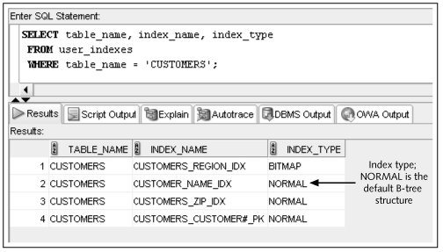
Verifying an Index (continued)

Slide 21
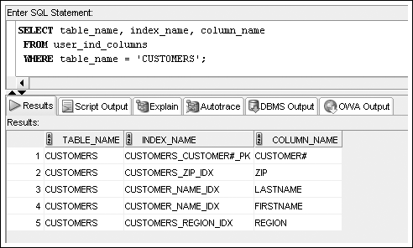
USER_IND_COLUMNS
21

Slide 22
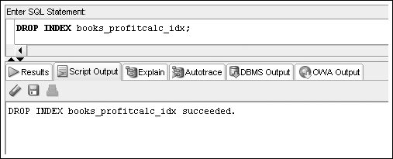
Removing an Index
DROP INDEX to remove an index

Slide 23
Topics not Discussed
We will not cover pages 206 – 209
BITMAP INDEXES
FUNCTION-BASED INDEXES
INDEX ORGANIZED TABLES
However, there is a hands on using BITMAP
Read about SYNONYMS on your own.

Slide 24
Oracle 12c: SQL
END OF Chapter 6
Additional Database Objects

